Slide 1


BeCode - AI- Fundamentals
LOADING - We will start in a couple minutes

Slide 2
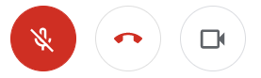
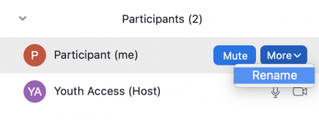
Tips for a comfortable session
Cut your microphone (Mute yourself)
Put your camera on (Not required)
Use your real name (Mr.Robot is a pseudonym) Rename yourself if it’s not the case

Slide 3
Introduction

Slide 4

Who are we?
Maxim
AI coach — BeCode.org
Machine learning engineer — Faktion
Web developer
BeCode learner
maxim@becode.org

Slide 5

Who are we?
Shoera
Project Lead — Radix.ai
Data Scientist — delaware
Mathematical Engineering — KU Leuven
shoera@radix.ai

Slide 6
Typical training day
Start at 9:00 sharp on google meet
9:00 -> 11:00 Intro of the day + theory or work
11:00 -> 11:15 Break
11:15 -> 12:30 Intro of the day + theory or work
12:30 -> 13:30 Lunch time
13:30 -> 14:00 Tech talk
14:00 -> 15:00 Work
15:00 -> 15:15 Break
15:15 -> 15:50 Work
15:50 -> 16:00 Debrief

Slide 7
Use Cases

Slide 8
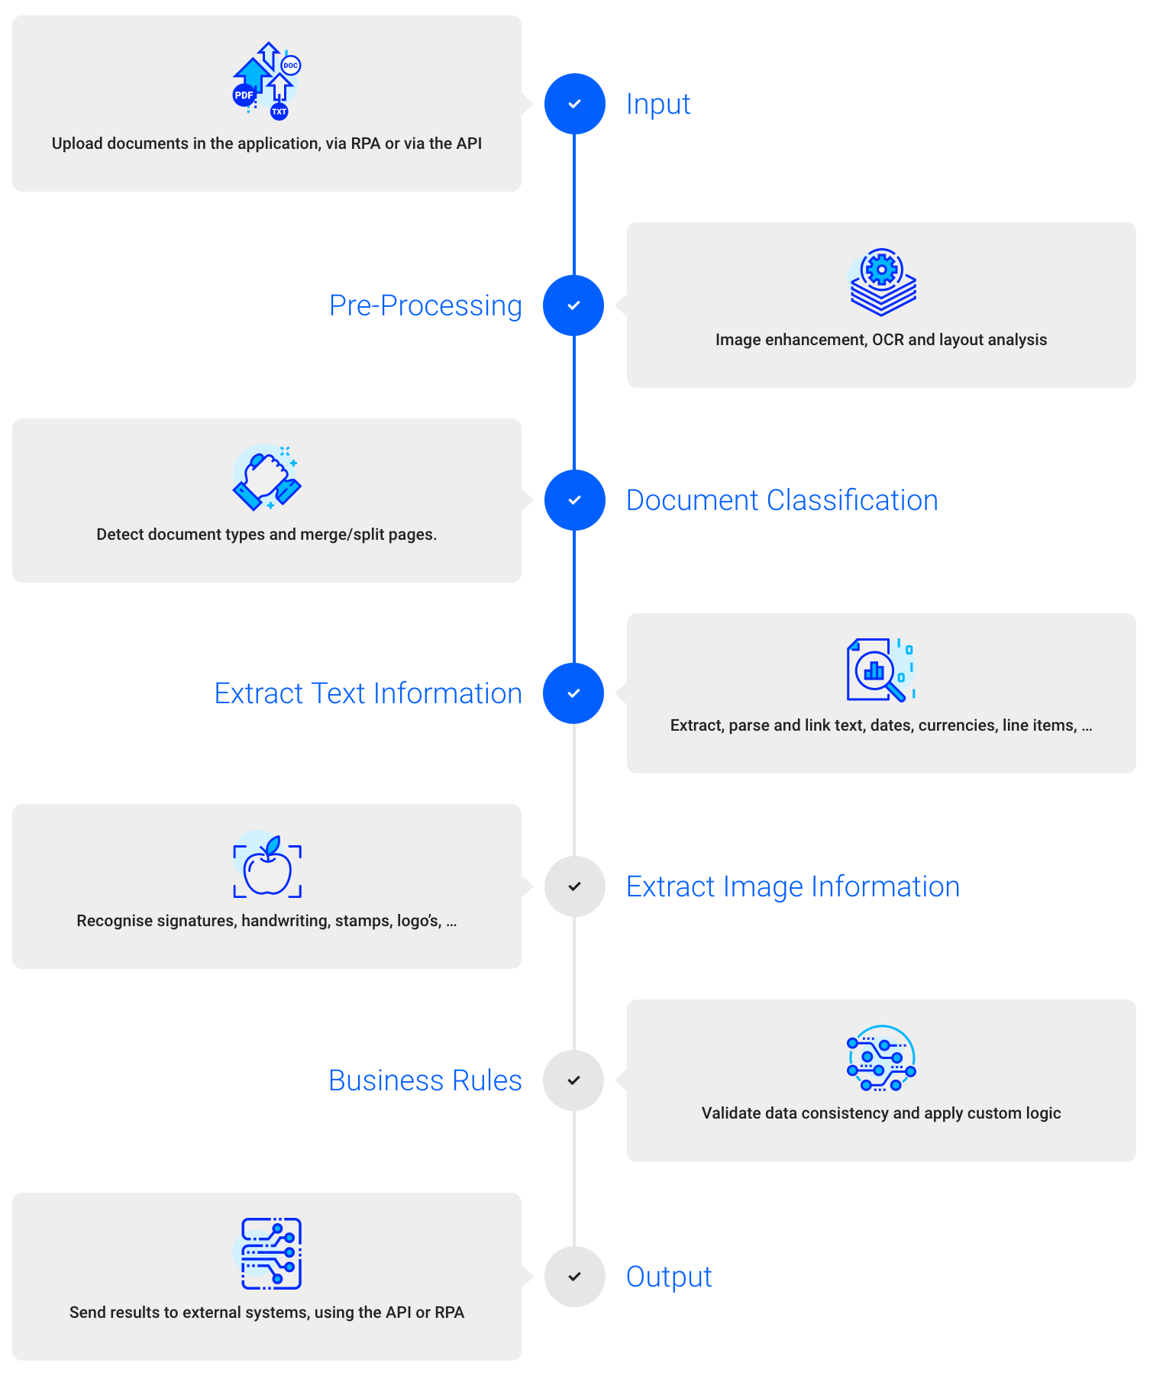
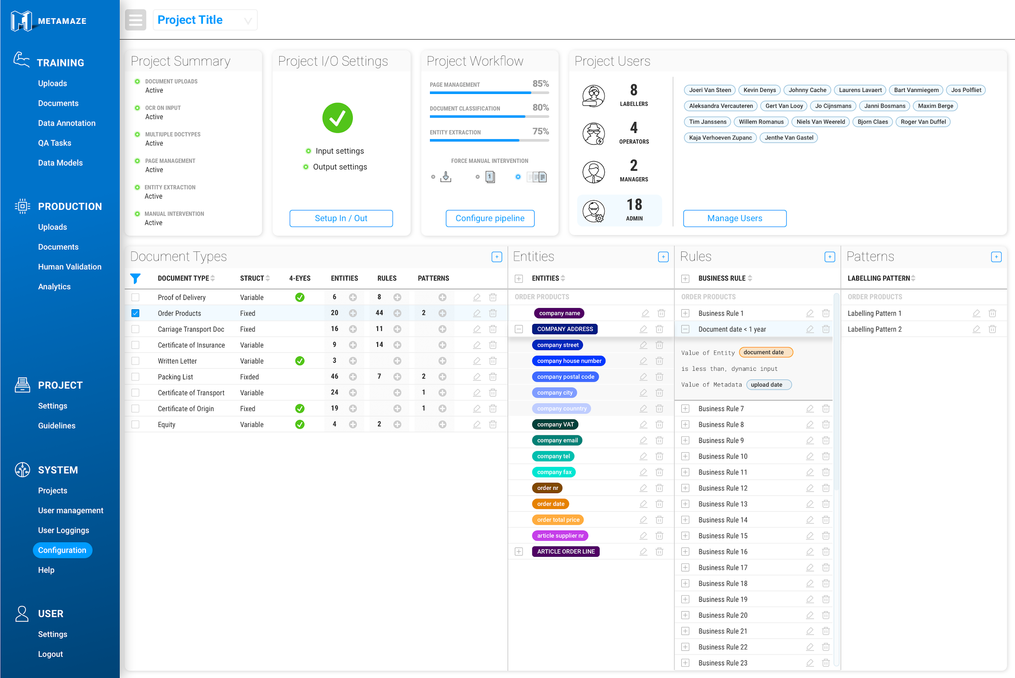
Automated document processing

Slide 9
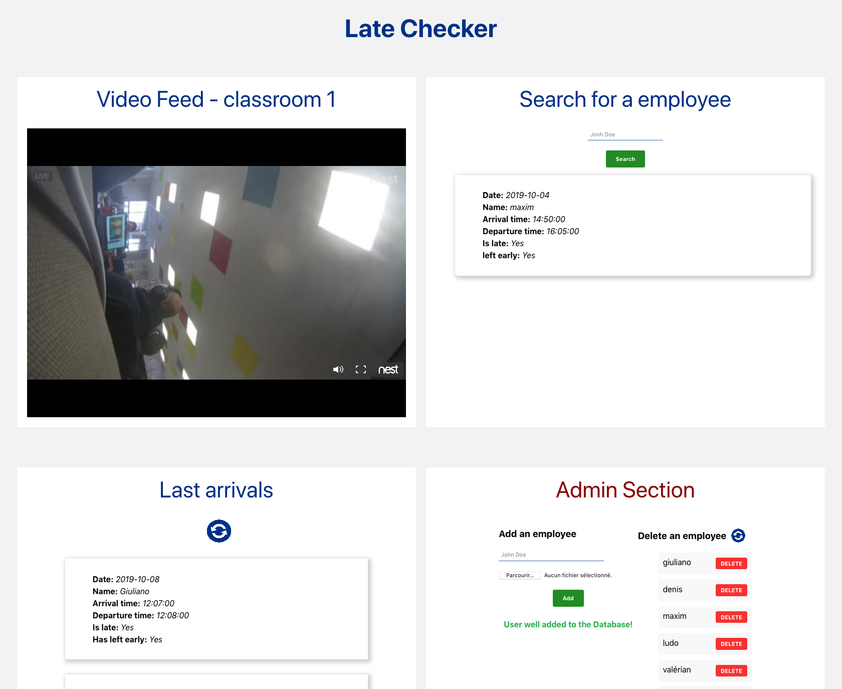
Face Recognition Project

Slide 10
Training Agenda

Slide 11
Agenda of the training
https://trello.com/b/t4bw8T5u/ai-fundamentals-learning-track

Slide 12
What is AI, ML, DL?

Slide 13
Artificial Intelligence
AI
Computers showing human-like intelligence
ML
DL

Slide 14
But, how do we define human-like intelligence?
Reason, use strategy, solve puzzle
Represent common sense knowledge
Plan and learn from past experience
Communicate in Natural Language
Integrate these skills for common goals

Slide 15
Alan Turing described intelligence in the following way
“A computer would deserve to be called intelligent if it could deceive a human into believing that it was human.”
— Alan Turing

Slide 16
Why now?
Data
Algorithms
Compute power

Slide 17
Machine learning
AI
ML
Algorithms that learn from data to make predictions
DL

Slide 18
Machine learning
First let then algorithm learn from past data, then let it make predictions on new data
AI
input
data
Machine Learning Model
output
data
Train Use historic data and corresponding outputs to train a model
AI
ML
ML
Predict Use the model to generate outputs for unseen data
input
data
Machine Learning Model
output
data

Slide 19
Deep learning
AI
ML
DL
Neural Networks

Slide 20
Deep learning
One specific model in machine learning, that has caught a lot of attention in the past few years
A common DL technique is a concept known as deep neural networks.
In a deep neural network, the code structures you write are arranged in layers that loosely mimic the human brain, learning patterns of patterns.

Slide 21
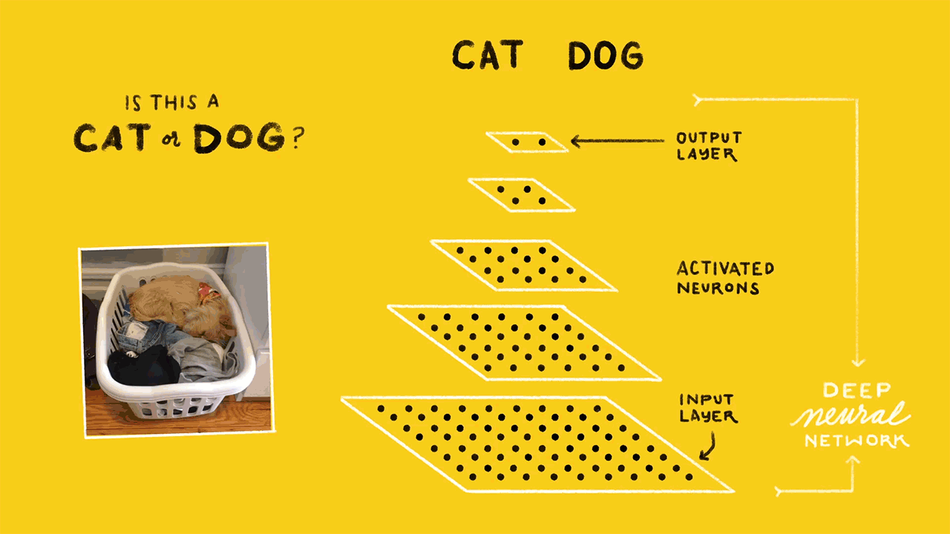
Notes:
Every layer will make decision on more complex

Slide 22
What is NLP?

Slide 23
Natural Language is hard
See the following example:
The complex houses married and single soldiers and their families.
This is called a Garden path sentence
= grammatically correct sentence that do not make sense

Slide 24
Natural Language is ambiguous
“I made him duck”
Did you prepare him a meal? Or did you give a swing at him?

Slide 25
Natural Language is uncertain?
“Call me a taxi”
Do you want me to get you a taxi or do you want me to tell you you are a taxi?

Slide 26
Computers like numbers, not words
Let computers perform useful tasks with natural language
= Natural Language Processing (NLP)

